Slide 1


Slide 3







Thank you to our Sponsors!
Notes:
Can’t emphasise enough how much they make it happen.
Platinum Sponsors:
University of Hull – Venue & support.
Black Marble – organisation, design etc.
NDC – general platinum.
Turbo360 – visit their stand.
Gold Sponsor
Sam – the event app.
Shirt Sponsor
Sage.
Agenda Sponsor
iO Associates.

Slide 5
Notes:
Logic Apps:
Provide us a Workflow Integration Platform
Operated by connectors which makes it perfect for integration senarios.
Its Low Code / No Code – easy to develop, maintain, debug and match to business process.
API Management is our Management Platform for a consolidated set of our API’s.
Perfect for API first approach
Revers Proxy – hides implementation away from callers
Loos Coupling
Powerful in capability through the use of Policies.
The Aim of this session is to look at ways to use these two services together effectively.
To simplify the connection of a logic app to APIM
To Secure its method of invocation
Well be looking at code samples and practical demos.

Slide 6
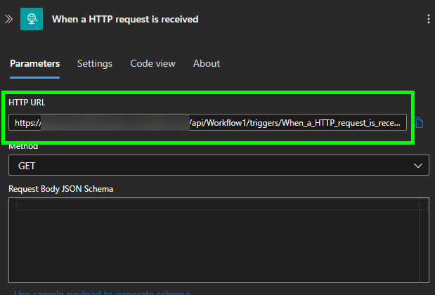

Slide 7
https://dddtestlogicapp.azurewebsites.net
/api/Workflow1/triggers/When_a_HTTP_request_is_received/invoke?
api-version=2022-05-01&
SAS query parameters:
sp=%2Ftriggers%2FWhen_a_HTTP_request_is_received%2Frun&
sv=1.0&
sig=w9JT9cne3w4sdfoXNx7r9VDJ3isdfsIKmvCu0V2hosdf
Notes:
api-version – this is the logic app service API version.
SAS query parameters
sp – specifies permissions for the allowed HTTP methods to use.
sv – specifies the SAS version to use for generating the signature.
sig – specifies the signature to use for authenticating the access to the trigger.
The key is kept secret, encrypted, and stored with the logic app.
The key is never exposed or published.
UNTIL NOW

Slide 8
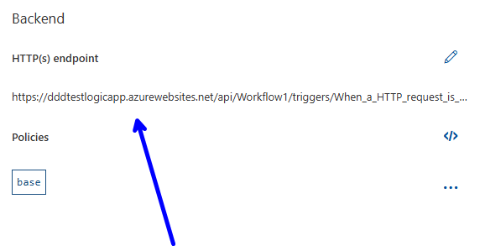

Slide 9
SAS Leak Mitigation
Always use HTTPS
Have a Revocation Plan
Have a Rotation Plan
Notes:
Always use HTTPS – If a SAS is passed over HTTP, an attacker can perform a man-in-the-middle attack and read the SAS key.
Have a revocation plan – make sure to have a plan for revoking a SAS key that is compromised.
Have a rotation plan – Look to replace the SAS key with new ones at regular intervals by regenerating the SAS key³.
Portal or Rest API

Slide 10
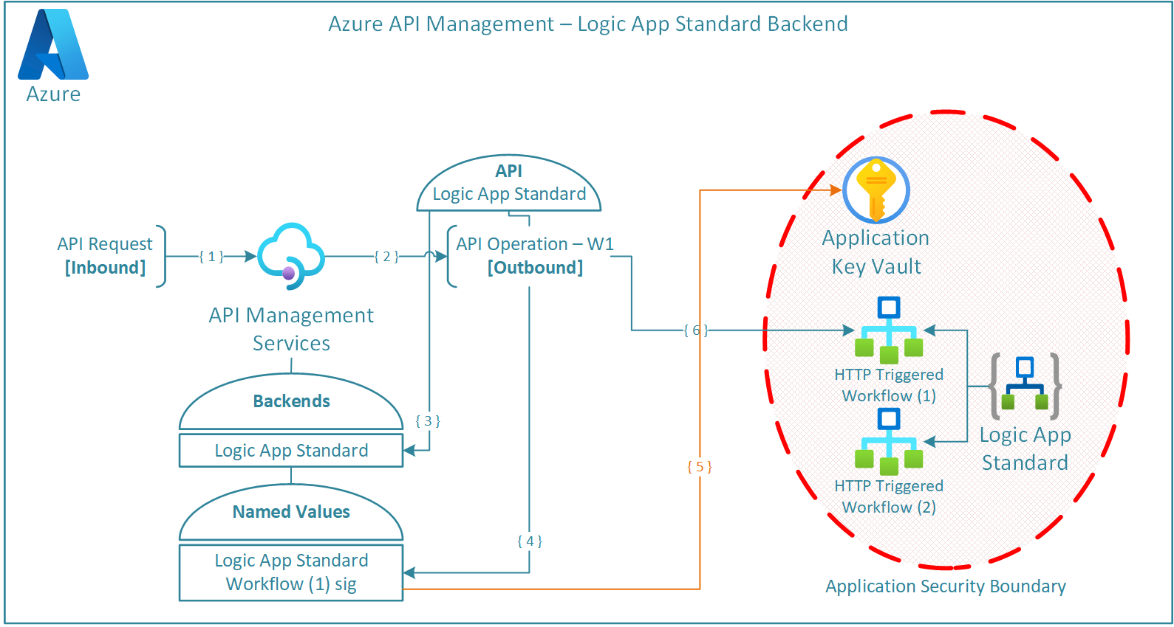

Slide 11
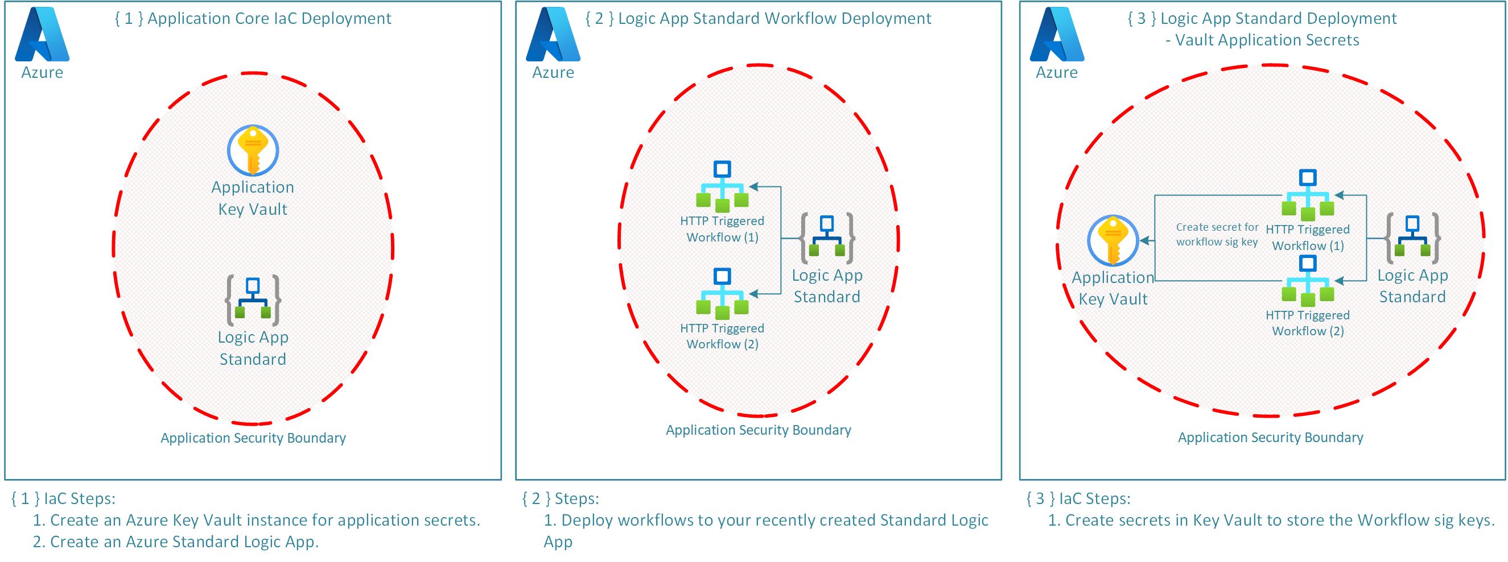

Slide 13
Notes:
APIM Components
Azure Role Assignment - This is the authorisation system that we will use to assign APIMs System Assigned Managed Identity access to the applications Key Vault, specifically the sig secret.
2. APIM Backend - APIM Backend is an HTTP service that implements a front-end API.
Setting up the Backend means that we can abstract backend service information, promoting reusability and improved governance.
3. APIM Named Values - This is a global collection of name/value pairs within the APIM Instance. Using APIM Policies we can use Named Values to further API configuration. Named Values can store constant string values, secrets, or more importantly Key Vault references to secrets.
4. APIM API and API Operations - Represents a set of available operations with each containing a reference to a backend service that implements the API.
5. APIM Policies - Policies are statements that are run sequentially on a given request or response for an API. These statements further our ability to configure the API and its abilities such as adding further parameters, setting a backend, making use of configured Named Values.

Slide 15
Logic App SAS Summary
Store and Access Securely
Adhere to SAS key Best Practices
Notes:
The logic app workflow SAS keys are stored and accessed securely.
This requires strict implementation of Principal of Least Privilege (RBAC) and Application Security Boundaries.
SAS key best practices are fully adhered to:
Always use HTTPS.
Have a revocation plan.
Have a rotation plan.

Slide 16
Is SAS the Best Way?
Can we use Identity?
Notes:
The logic app workflow SAS keys are stored and accessed securely.
This requires strict implementation of Principal of Least Privilege (RBAC) and Application Security Boundaries.
SAS key best practices are fully adhered to:
Always use HTTPS.
Have a revocation plan.
Have a rotation plan.

Slide 17
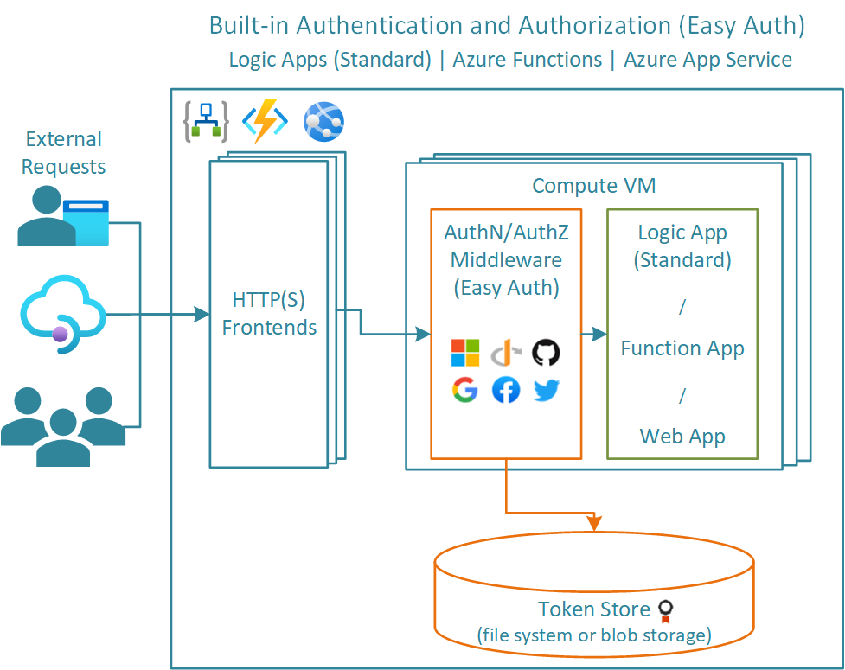
Easy Auth
Notes:
Easy Auth is a built-in authentication and authorisation capability provided by Azure App Services and Azure Functions.
Easy Auth makes use of federated identity whereby a third-party identity provider manages the user identities and authentication flow for you.
Fortunately for us, Standard Logic Apps have the same foundations as Azure Functions and therefore Easy Auth is also extended to Logic Apps Standard.
How does it work…
Easy Auth is a platform feature running on the same virtual machine as your application.
Once enabled, any incoming HTTP requests will pass through this feature prior to being handled by your application.
Easy Auth runs separately from your application code and can be configured using ARM settings or using a configuration file.

Slide 18
Notes:
In short, both methods are valid mechanisms in securing your integration workflows behind API Management. Where possible, implement Easy Auth due to stronger security through identity. If the decision is to use SAS keys, make sure to take count of the wider picture and best practices:
Securely store and protect access to the SAS keys.
Adhere to SAS key best practices:
Always use HTTPS.
Have a revocation plan.
Have a rotation plan.

Slide 19






Thank you for your time
Any Questions?

